Slide 1
Programming Language II CSE-215
Prof. Dr. Mohammad Abu Yousuf
yousuf@juniv.edu

Slide 2
Comparison between C++ and Java

Slide 3
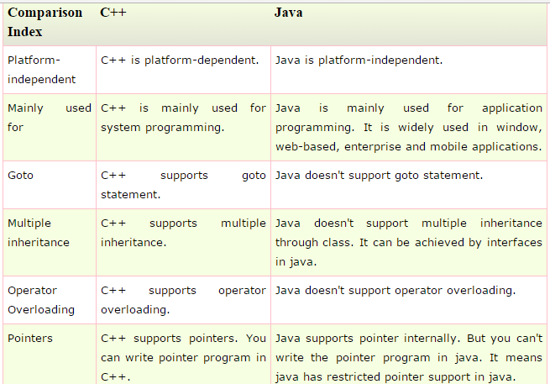

Slide 4
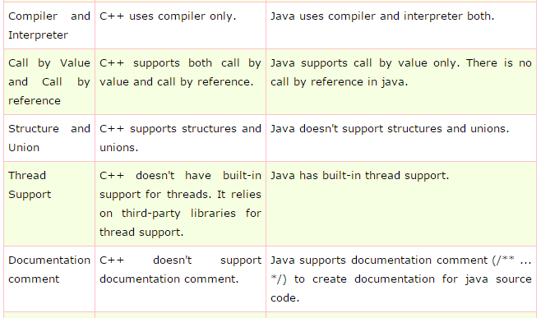

Slide 5
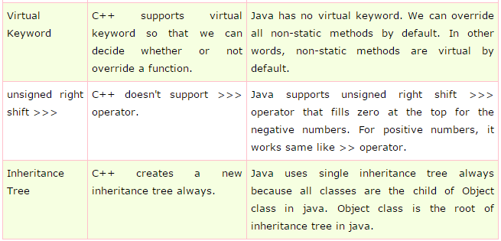

Slide 6
Variable :
There are three types of variables: local, instance and static.
Local Variable:
A variable that is declared inside the method is called local variable.
Instance Variable:
A variable that is declared inside the class but outside the method is called instance variable . It is not declared as static.
Static variable:
A variable that is declared as static is called static variable. It cannot be local.

Slide 7
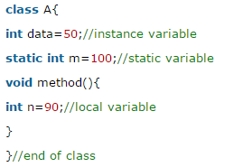
Example:

Slide 8
Control Statements

Slide 9
Java’s Selection Statements
Java supports two selection statements: if and switch.
These statements allow you to control the flow of your program’s execution based upon conditions known only during run time.
There are various types of if statement in java.
if statement
if-else statement
nested if statement
if-else-if ladder

Slide 10
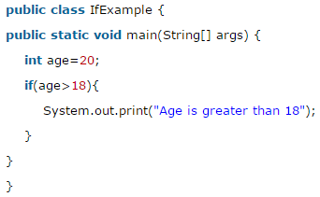
Java If statement:
if (condition) statement1;

Slide 11
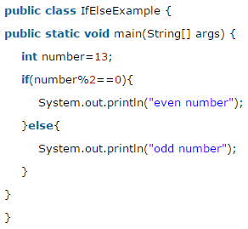
Java IF-else Statement
if (condition) statement1;
else statement2;

Slide 12
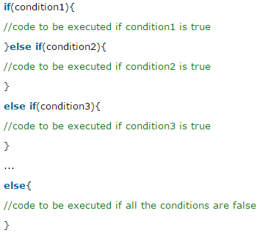
Java IF-else-if ladder Statement

Slide 13
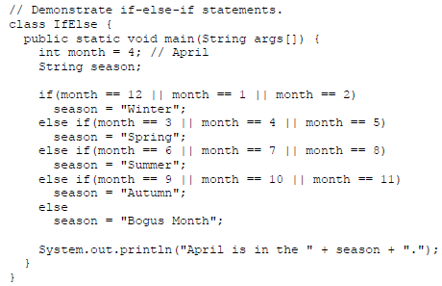

Slide 14
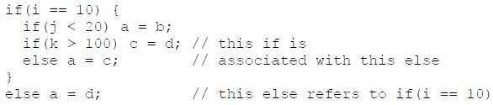
Java Nested ifs:

Slide 15
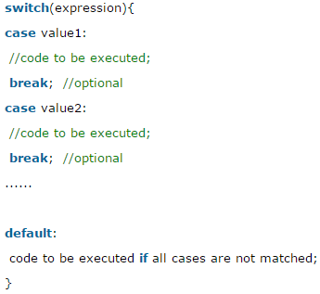
Java Switch Statement:
expression must be of type byte, short, int, char, or an enumeration.
Expression can also be of type String.
Each value specified in the case statements must be a unique constant expression (such as a literal value). Duplicate case values are not allowed. The type of each value must be compatible with the type of expression.

Slide 16
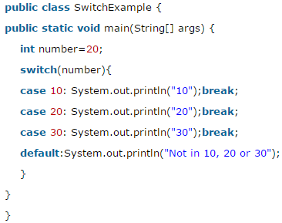
Example:

Slide 17
The break statement is optional. If you omit the break, execution will continue on into the next case.
It means it executes all statement after first match if break statement is not used with switch cases.
It is sometimes desirable to have multiple cases without break statements between them.

Slide 18
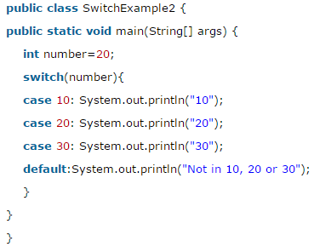
Output:
20
30
Not in 10, 20 or 30

Slide 19
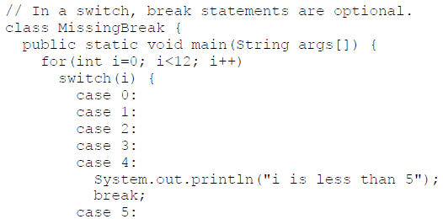
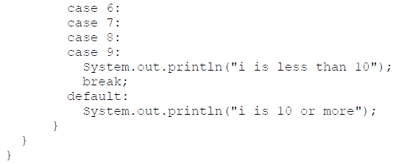
For example:

Slide 20
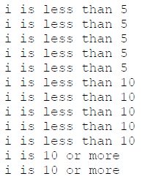
Output:

Slide 21
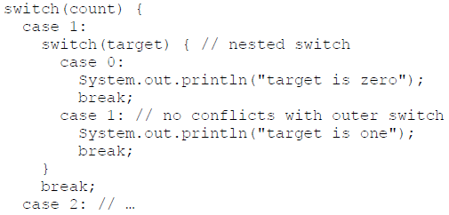
Nested switch Statements:

Slide 22
Iteration Statements

Slide 23
Java’s iteration statements are for, while, and do-while. These statements create what we commonly call loops.

Slide 24

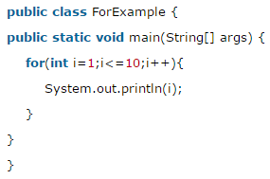
For loop:

Slide 25
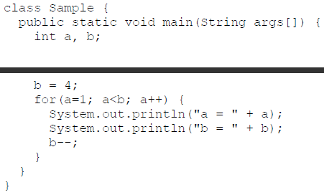
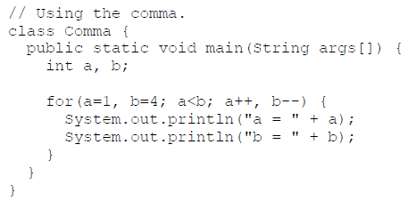
Using the Comma in for loop:

Slide 26
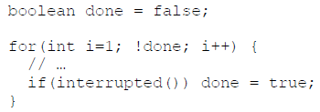
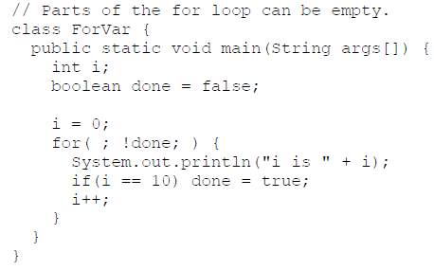
Some for Loop Variations
In this example, the for loop continues to run until the boolean variable done is set to true. It does not test the value of i.
Here, the initialization and iteration expressions have been moved out of the for. Thus, parts of the for are empty.

Slide 27
Java For-each Loop:
The for-each loop is used to traverse array or collection in java. It is easier to use than simple for loop because we don't need to increment value and use subscript notation.
It works on elements basis not index. It returns element one by one in the defined variable.

Slide 28

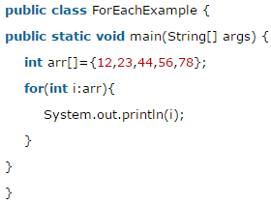
Java For-each Loop:
Output:
12
23
44
56
78

Slide 29
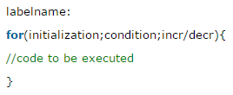
Java Labeled For Loop:
We can have name of each for loop. To do so, we use label before the for loop. It is useful if we have nested for loop so that we can break/continue specific for loop.
Normally, break and continue keywords breaks/continues the inner most for loop only.

Slide 30
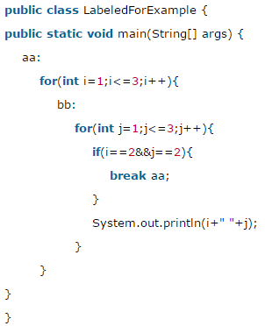

If you use break bb;, it will break inner loop only which is the default behavior of any loop.

Slide 31
Using break to Exit a Loop:
By using break, you can force immediate termination of a loop, bypassing the conditional expression and any remaining code in the body of the loop.
When a break statement is encountered inside a loop, the loop is terminated and program control resumes at the next statement following the loop.

Slide 32
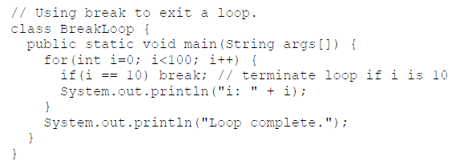
Example:

Slide 33
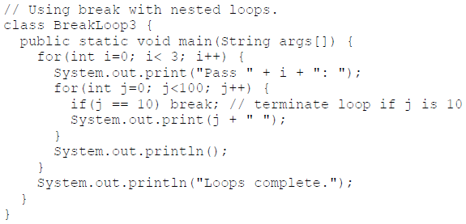

When used inside a set of nested loops, the break statement will only break out of the innermost loop.

Slide 34
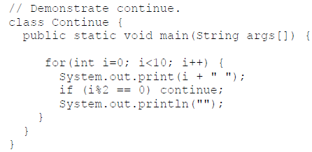
Using continue:
Sometimes it is useful to force an early iteration of a loop. That is, you might want to continue running the loop but stop processing the remainder of the code in its body for this particular iteration.
The continue statement performs such an action.

Slide 35
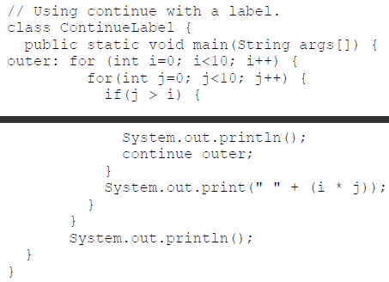
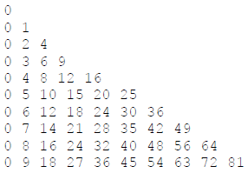
As with the break statement, continue may specify a label to describe which enclosing loop to continue.

Slide 36
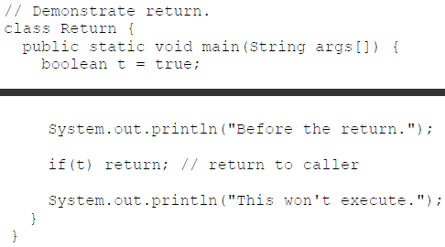
return statement:
The return statement is used to explicitly return from a method. That is, it causes program control to transfer back to the caller of the method.
As you can see, the final println() statement is not executed. As soon as return is executed, control passes back to the caller.
Output:
Before the return.

Slide 37
Thank you

